Slide 1
Project Title:
Emotion-Detection

Slide 2
Introduction:
This project aims to classify the emotion on a person's face into one of five categories, using deep convolutional neural networks. The model is trained on the FER-2013 dataset which was published on International Conference on Machine Learning (ICML). This dataset consists of 35887 grayscale, 48x48 sized face images with five emotions 'Angry' ,'Happy' , 'Neutral ','Sad' and 'Surprise'
Emotion detection has become a topic of continuous research and innovation as over the past decade the limitations of computer vision have been lifted by the introduction of machine learning. As machine learning algorithms leverage the huge computation power of GPU’s, the image processing capabilities of these models fit suitably with real world problems. Computer vision has spread from a novel domain to several other domains such as the behavioural sciences. These algorithms or models are being used in various real-world applications across several fields such as security, driver-safety, autonomous vehicles, human-computer interaction and healthcare.

Slide 3
Introduction
The project work entitled "Facial Emotion Detection Using Machine Learning" would envisage the following:
Capturing static images for pre-processing.
Feature Extraction using Deep Neural Networks.
Implementing a convolutional neural network to classify images based on the aforementioned features

Slide 4
DATASET:
This model is capable of recognizing seven basic emotions as following:
Happy
Sad
Angry
Surprise
Neutral
The FER-2013 dataset consists of 28,709 labelled images in the training set and 7,178 labelled images in the test set. Each image in this dataset is labelled as one of seven emotions: happy, sad, angry, afraid, surprise, disgust, and neutral. The faces have been automatically registered such that the face is more or less cantered and occupies about the same amount of space in each image.
In this project, we will be using Deep Learning(CNN) and Computer Vision.

Slide 5
WHAT IS DEEP LEARNING:
Machine Learning (ML) and Deep Learning are subsets of Artificial Intelligence. Deep Learning represents the next evolution in Machine Learning. In Deep Learning, the model learns through an artificial neural network that is very much similar to a human brain and this allows the model to analyse data in a structure much similar to humans do. Deep Learning models don’t require a human programmer to intervene and tell what to do with the data. It is self-capable of learning from the extraordinary amount of data provided to it.
In deep learning, a computer model learns to perform classification tasks directly from images, text, or sound. Deep learning models can achieve state-of-the-art accuracy, sometimes exceeding human-level performance. Models are trained by using a large set of labelled data and neural network architectures that contain many layers.

Slide 6
What is a Neural Network?
A neural network is a series of algorithms that endeavours to recognize underlying relationships in a set of data through a process that mimics the way the human brain operates. In this sense, neural networks refer to systems of neurons, either organic or artificial in nature. Neural networks can adapt to changing input; so the network generates the best possible result without needing to redesign the output criteria. The concept of neural networks, which has its roots in artificial intelligence. is swiftly gaining popularity in the development of trading systems.

Slide 7
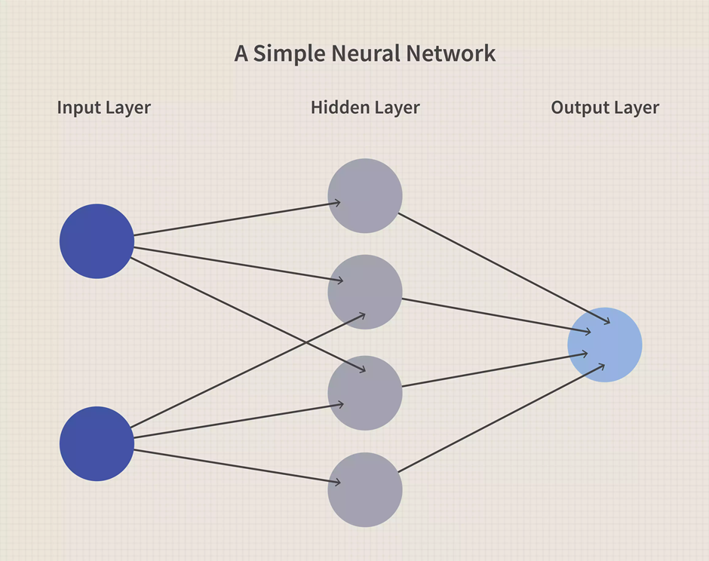
What is a Neural Network?

Slide 8
COMPUTER VISION:
Computer vision provides the ability for the computer to see as humans see. It is the part of computer science that is focused on replicating the intricate parts of the human visual system. It helps identify and process the objects in images through the computer.
Deep learning has delivered superhuman accuracy for image classification, object detection, image restoration, and image segmentation. It uses enormous neural networks to teach machines how to automate the tasks performed by human visual systems. It is a field that aims to gain a deep understanding through digital images or videos.

Slide 9
INTRODUCTION TO OpenCV:
There are some predefined packages and libraries in python as part of Computer Vision which can make our life quite simple and OpenCV is one of them. It helps us develop a system that can process images and real-time video using computer vision. OpenCV (Open Source Computer Vision Library) is an open-source computer vision and machine learning software library which is easy to import in Python. We will be using HaarCascade algorithm in the model. It is a machine learning-based approach where a cascade function is trained using a whole lot of positive and negative images. It is then used to detect objects in other images.
We’re using Google Colab as part of this blog. It’s a browser-based Jupyter notebook service that’s available for free. This service is fit for Deep Learning and Machine Learning applications. It does not require any additional setup or installation. It helps us to run Python code via the browser. It also allows us to share these notebooks without having to download them.

Slide 10
Keras:
Deep learning is one of the major subfield of machine learning framework. Machine learning is the study of design of algorithms, inspired from the model of human brain. Deep learning is becoming more popular in data science fields like robotics, artificial intelligence(AI), audio & video recognition and image recognition. Artificial neural network is the core of deep learning methodologies. Deep learning is supported by various libraries such as Theano, TensorFlow, Caffe, Mxnet etc., Keras is one of the most powerful and easy to use python library, which is built on top of popular deep learning libraries like TensorFlow, Theano, etc., for creating deep learning models.

Slide 11
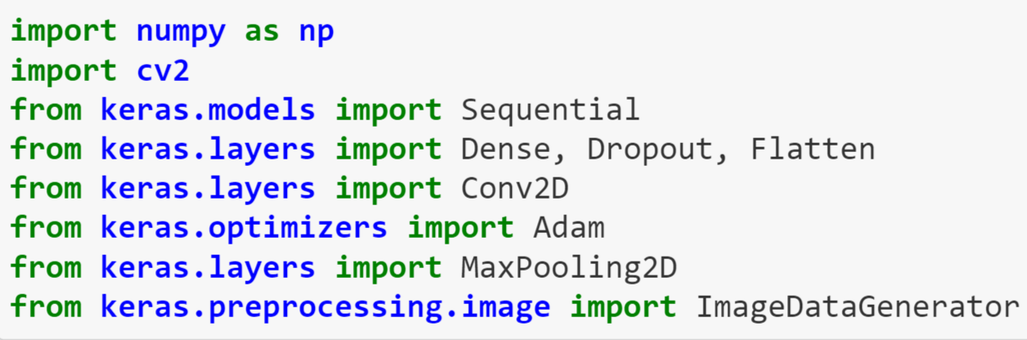
Code and working:
1.Import packages:

Slide 12
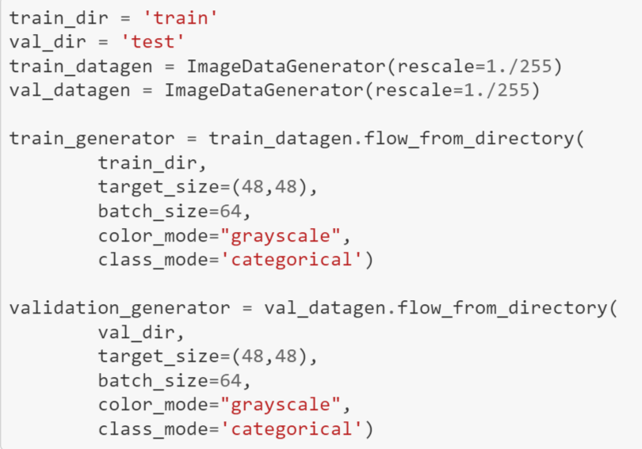
Code and working:
2. Initializing Training And Test Generators:
Keras ImageDataGenerator augments the images in real-time while the model is still training. Any random transformation can be applied to each training image as it is passed to the model. This not only makes the model robust but also saves the overhead memory.
When we run this cell, the total records in the output will be the addition of the training and testing data. In our model, we are using 28,709 images in the test and 7,178 images in the test set.

Slide 13

Code and working:

Slide 14
Code and working:
3.Building the Convolutional Neural Network (CNN) Model:
ResNet50 also known as Residual Networks is a classic neural network used in many computer vision tasks. The 50 in the ResNet stands for a convolution neural network that is 50-layer deep. The main aim of this model is to avoid poor accuracy as the model becomes deeper. ResNet50 is a pre-trained model on top of which we are going to train our own model.
ResNet model is proposed to solve the issue of diminishing gradient. The basic idea is to skip the connections and pass the residual to the next layer so that the model continues to train. Using this ResNet model on top of our CNN model, our models can go deeper and deeper.

Slide 15
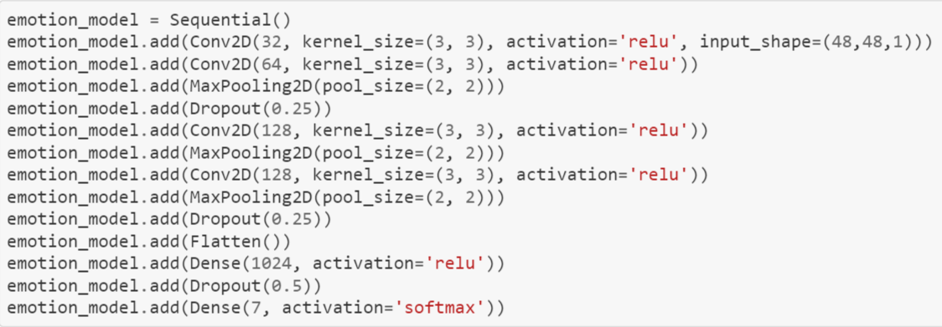
Code and working:

Slide 16
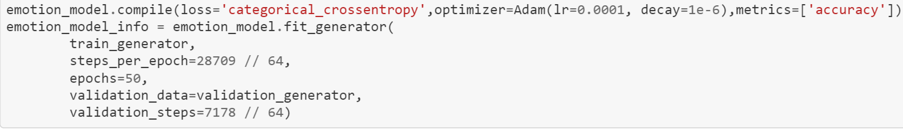
Code and working:
4. Compiling and Training the Model:
Categorical_crossentropy computes the crossentropy loss between labels and predictions. Crossentropy loss function is used when there are two or more label classes.
The Optimizer is one of the two arguments required for compiling a Keras model.
In this model, we are using Adam optimizer.

Slide 17

Code and working:
5.Saving the Model:

Slide 18
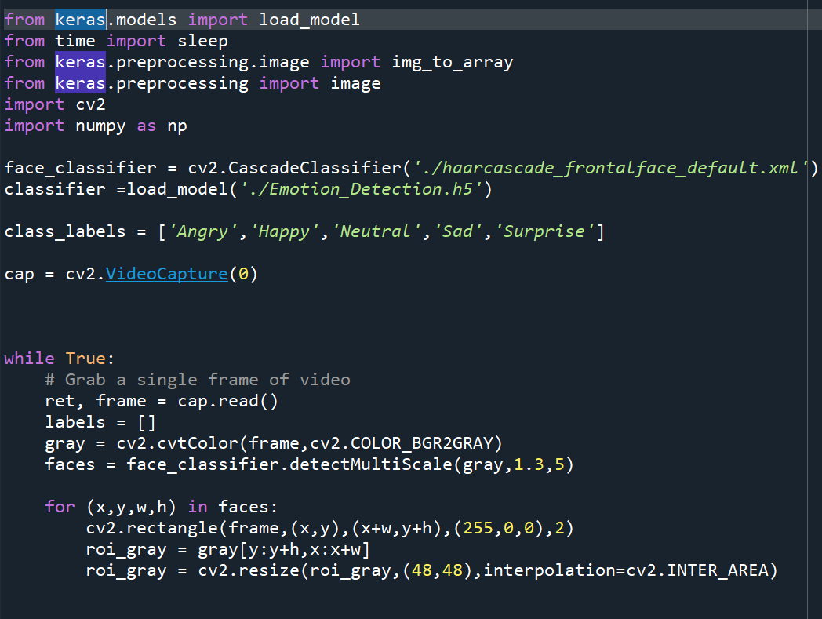
Now, for testing the model:

Slide 19
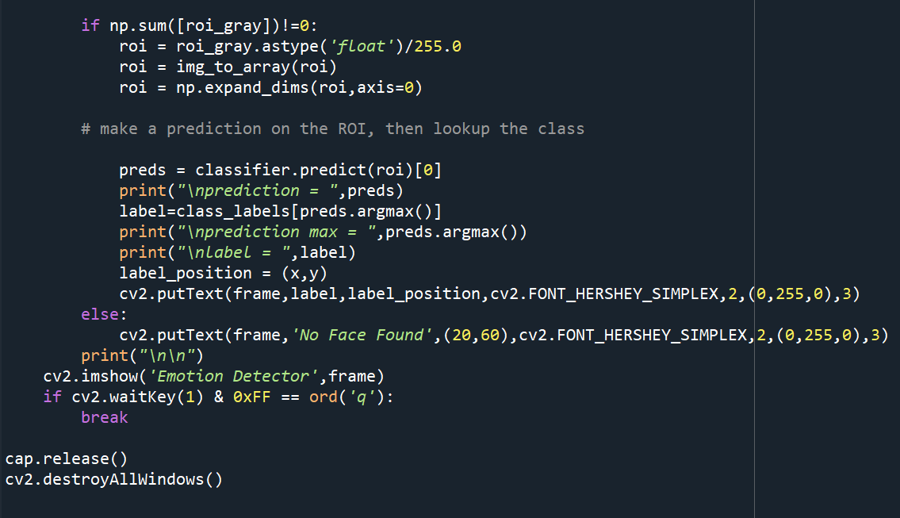
Now, for testing the model:

Slide 20
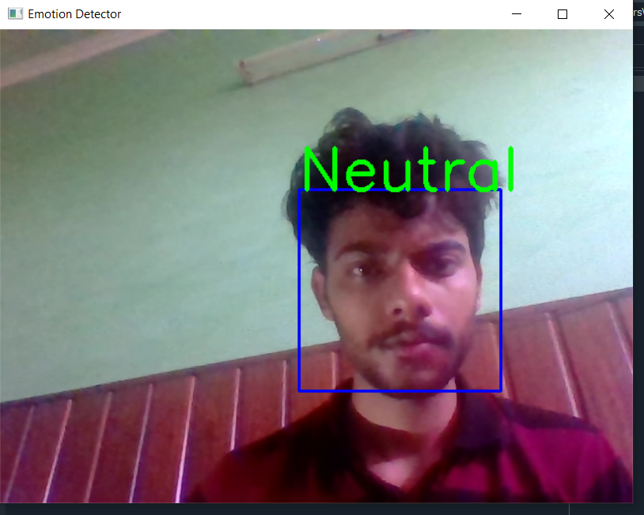
Output Screenshots:

Slide 21
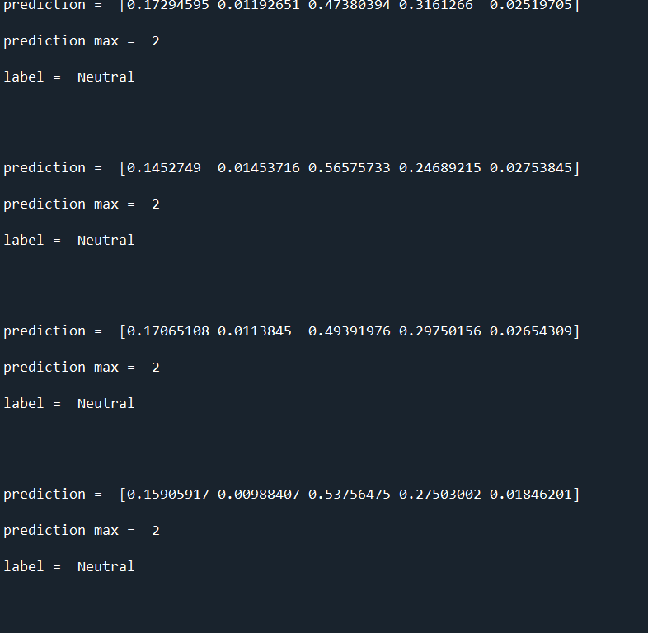
Output Screenshots:

Slide 22
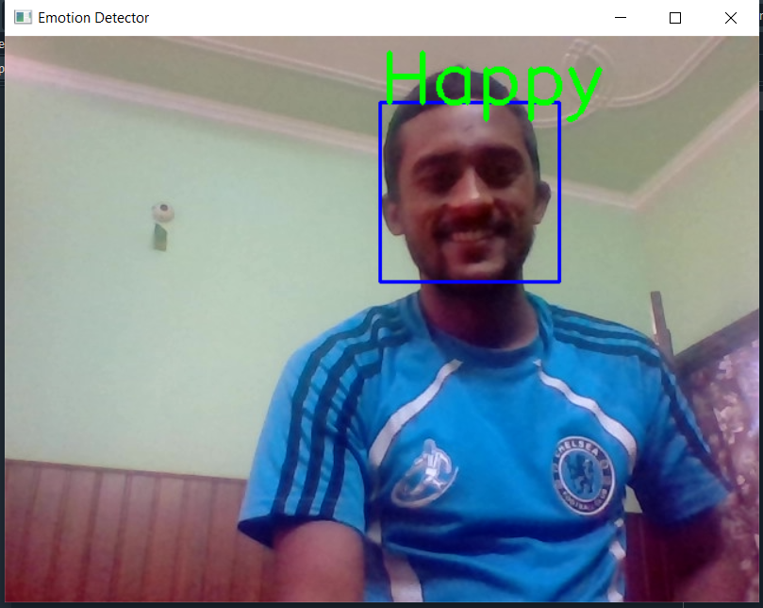
Output Screenshots:

Slide 23
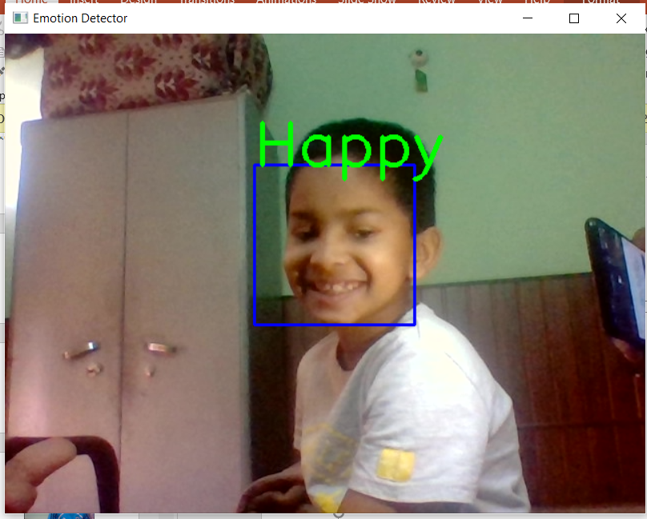
Output Screenshots:

Slide 24
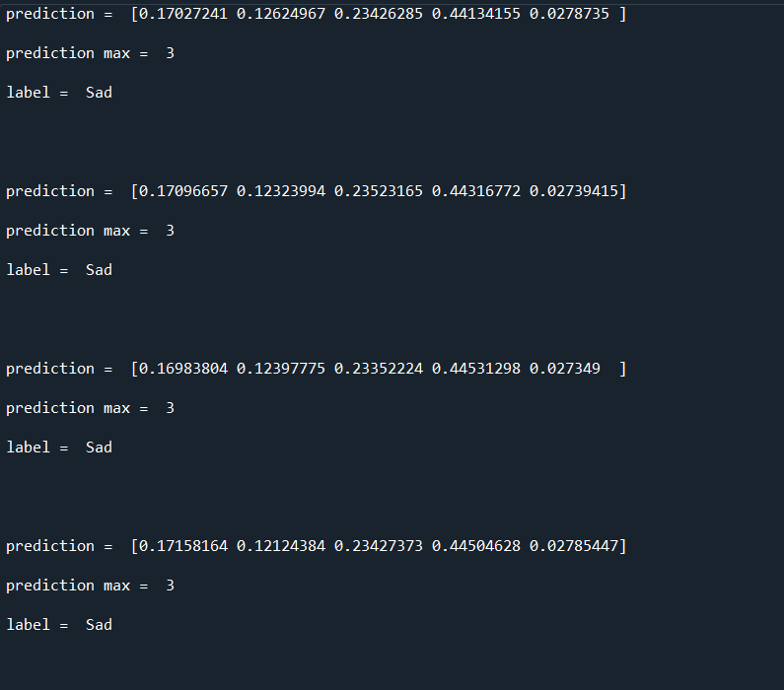
Output Screenshots:

Slide 25
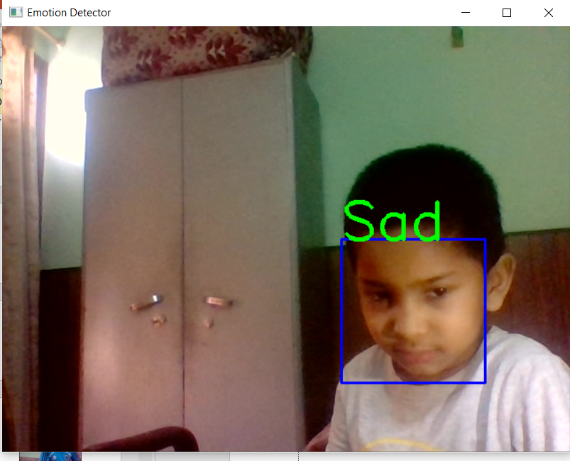
Output Screenshots:

Slide 26
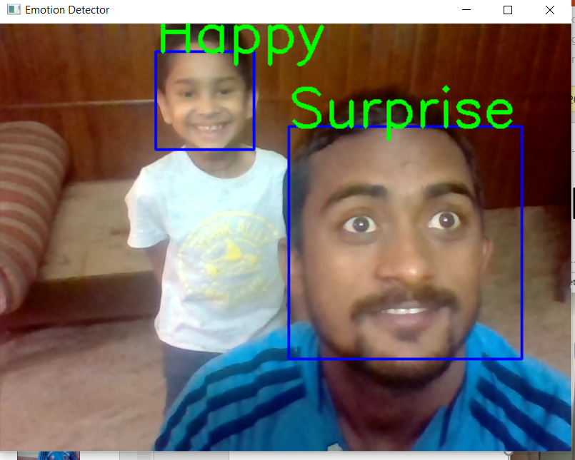
Output Screenshots:

Slide 27
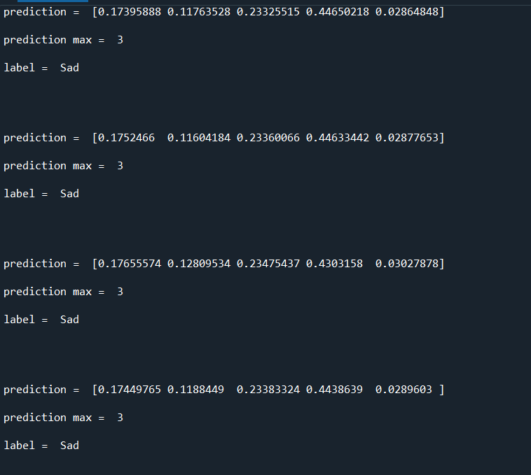
Output Screenshots:

Slide 28
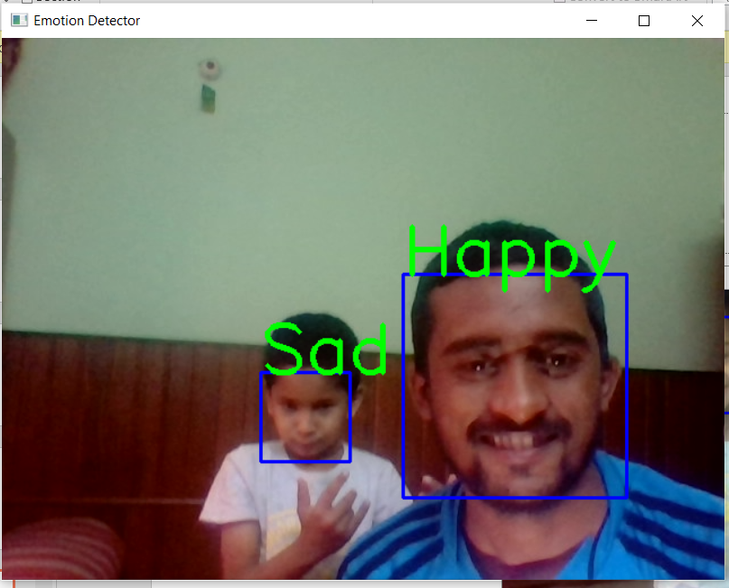
Output Screenshots:

Slide 29
CONCLUSION:
Through this project, I have tried to provide brief information on how Emotion Recognition works using Deep Learning. We trained our Convolutional Neural Network Model on top of pre-trained data (ResNet50)and we also used Computer Vision as part of this model. Haarcascade is the package used from OpenCV to detect objects in other images.
We trained the model with several images and then used the test images to see how the results match up. We trained the model through epochs. In this model, we have taken epochs as 100. Once the threshold is achieved by the model and if we further try to train our model, then it will provide unexpected results and its accuracy will also decrease. After that, increasing the epoch would also not help. Hence, epochs play a very important role in deciding the accuracy of the model, and its value can be decided through trial and error.
For this model, the accuracy that we achieved for the validation set is 63%. To further increase the accuracy of the model, we can either expand the training dataset we have or increase the step size for the model. Through these parameters, we can increase the model accuracy for this model.

Slide 30
Thank You

